Slide 1
Proposal of YFVE Digital QA Platform
Implementation Team, Omnex
2018/1/24

Slide 2
Agenda
Customer Requirements
Background & Pain Point
Requirements Specification
Understanding of Customer Requirements
Functional Requirements
None-Functional Requirements
Business Structure
OMNEX Solution
Application Architecture
System Architecture
System Deployment Architecture
System Security
System Integration
Application Feature List
Implementation & Release Plan
Q&A

Slide 3
Agenda
Customer Requirements
Background & Pain Point
Requirements Specification
Understanding of Customer Requirements
Functional Requirements
None-Functional Requirements
Business Structure
OMNEX Solution
Application Architecture
System Architecture
System Deployment Architecture
System Security
System Integration
Application Feature List
Implementation & Release Plan
Q&A

Slide 4
Customer Requirements - Background & Pain point
YFVE is using the e-mail to track the status of APQP,PPAP,PPQP of each suppliers; there is no data collection and storage, need lots of time to consolidate the data, low work efficiency.
YFVE suppose to improve their QA project management efficiency and manage the risks, and then build up a efficient information management system to monitor the APQP process, track issues, demonstrate the APQP project statistics.
Cooperative work required from multi entities, then the content management(mainly for document management and version control) requirement is mandatory.

Slide 5
Customer Requirements - Requirements Specification
To build up the APQP management platform for suppliers and realize the submit, approval, monitoring, statistics and storage, the main functions are listed below:
Task start up: integrate with YFVIC system to trigger the task automatically, or trigger the task manually.
Data submit: suppliers have to submit the tasks by the pre-defined time line, and suppliers will get he notifications automatically before each time line.
Approval: YFVIC SQE will audit the materials that submitted by the suppliers and decide to reject or approve the application. The system should allow YFVIC SQE to log the reject reasons or comments, and all the historical records should be logged automatically.
Monitoring: this any tasks expired, the system should send notification to SQE and suppliers, and also can escalate the tasks to higher level managers according to the expired date pre-defined.
Statistics (report): to generate the report by three dimensions (by projects, by suppliers, by SQE)
ALL BUSINESS DATA NEED TO BE STORED AT LEAST FOR 15 YEARS.
EXTERNAL INTERFACE: to realize the standard input/output functions according to YFVE’s detailed requirements.

Slide 6
Agenda
Customer Requirements
Background & Pain Point
Requirements Specification
Understanding of Customer Requirements
Functional Requirements
None-Functional Requirements
Business Structure
OMNEX Solution
Application Architecture
System Architecture
System Deployment Architecture
System Security
System Integration
Application Feature List
Implementation & Release Plan
Q&A

Slide 7
Requirements Understanding - Functional Requirements – Main Process
Clarence & Steven
APQP
PPAP
PPQP
Parts

Slide 8
Requirements Understanding - None-Functional Requirements
The application should be deployed on the cloud, and the following characteristics should be considered :
Capabilities
Stability
Scalability
Security (system level and application level)
System Logging strategy

Slide 9
Agenda
Customer Requirements
Background & Pain Point
Requirements Specification
Understanding of Customer Requirements
Functional Requirements
None-Functional Requirements
Business Structure
OMNEX Solution
Application Architecture
System Architecture
System Deployment Architecture
System Security
System Integration
Application Feature List
Implementation & Release Plan
Q&A

Slide 10
OMNEX Solution Proposed - Application Architecture
Steven
PPQP
APQP
PPAP
Supplier Quality Management System
SQEM
Org Management
Account Management
Content Management
SQE
Project Management
Workflow Management
(or Task Mgt)
Notification Management
Issue Management
Report Management
Others(Mail, )
SUPPLIER
doc
data
BPM(modifications, project kick-off…)
DMS(Hyper-link to file server)
QAD(Suppliers’ information)
Each sub-company has an individual BPM, has to realize in phase II

Slide 11
OMNEX Solution Proposed - System and Integration Architecture
Steven

Slide 12
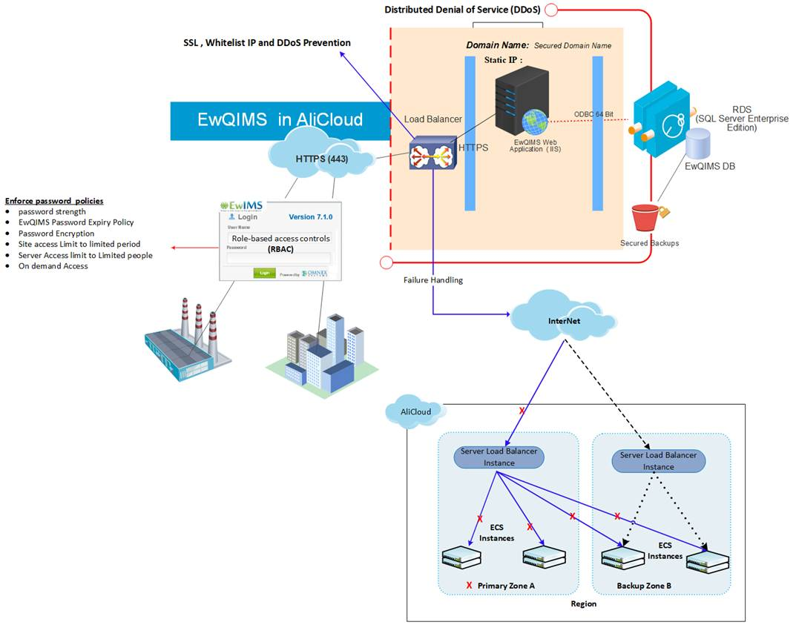
OMNEX Solution Proposed - System Deployment Architecture (On Ali Cloud)
Notes:
1, need a diagram to demonstrate the whole system’s infrastructure;
2, need to avoid the single point of failure in our design;
3, the suggested hardware configuration should be provided here(according to user’s usage situation);
Total users number will be 500 or more;
According to Li Zhuo’s estimation, the concurrent users at peak time will be 100-200,

Slide 13
OMNEX Solution Proposed - System Logging Methodology
Sabu

Slide 14
OMNEX Solution Proposed - System Feature List
Chris & Steven
We need to provide the feature list here and map to the user’s requirements as well.

Slide 15
Agenda
Customer Requirements
Background & Pain Point
Requirements Specification
Understanding of Customer Requirements
Functional Requirements
None-Functional Requirements
Business Structure
OMNEX Solution
Application Architecture
System Architecture
System Deployment Architecture
System Security
System Integration
Application Feature List
Implementation & Release Plan
Q&A

Slide 16
Implementation & Release Plan - Project Plan
Chris
2016
2017
Project milestone
Apr
May
Jun
Jul
Aug
Sep
Oct
Nov
Dec
Jan
Feb
Mar
Apr
May
Jun
Interview
Define detail business model
Sample
Define operation model
Define E-commerce functional requirement
Business operation and execution on-site support
Communication & Rollout
April 8th, 2016
March 31st, 2017

Slide 17
Implementation & Release Plan - Release Plan
Chris
Modules G, H, I
Modules D, E, F
To describe the requirements should be fulfilled in this phase;
Improvement continuously
Modules A, B,C
To describe the requirements should be fulfilled in this phase;
To describe the requirements should be fulfilled in this phase;
Sample
Phase I
Phase II
Phase III
time

Slide 18
Implementation & Release Plan - Resource Plan
Chris

Slide 19
Agenda
Customer Requirements
Background & Pain Point
Requirements Specification
Understanding of Customer Requirements
Functional Requirements
None-Functional Requirements
Business Structure
OMNEX Solution
Application Architecture
System Architecture
System Deployment Architecture
System Security
System Integration
Application Feature List
Implementation & Release Plan
Q&A

Slide 20
Thanks!

